Slide 1

Linux toolset for DevOps
DevOps Community Moldova
Speaker: Andrei Prescornic
2023

Slide 2
Become DevOps
DevOps roadmap
Learning resources
Community and teams
bash shell and scripting
vim, grep, sed, awk, regex
systemd, cron jobs
How to become a DevOps Engineer?
Linux commands and tools
Network commands
ssh
Remote connection managers
Network basic tools
To become a DevOps Engineer, you need to have technical skills in areas such as development, automation, containerization, cloud, CI/CD pipelines etc. Some sample tools and technologies to learn may include any programming language, AWS, Ansible, Terraform, Docker, Kubernetes, Jenkins, Git, and monitoring and logging tools. Gain experience by working on DevOps projects, develop a DevOps mindset, get certified, and apply for DevOps Engineer positions by highlighting your skills and experience in your resume.
Tasks planning, Wiki
Git
Communication
Collaborating
IDE
﻿diff and comparing content
tmux, screen ….
IDE and coding
Browser and web tools
Logging tools
Monitoring
Testing and investigating

Slide 3
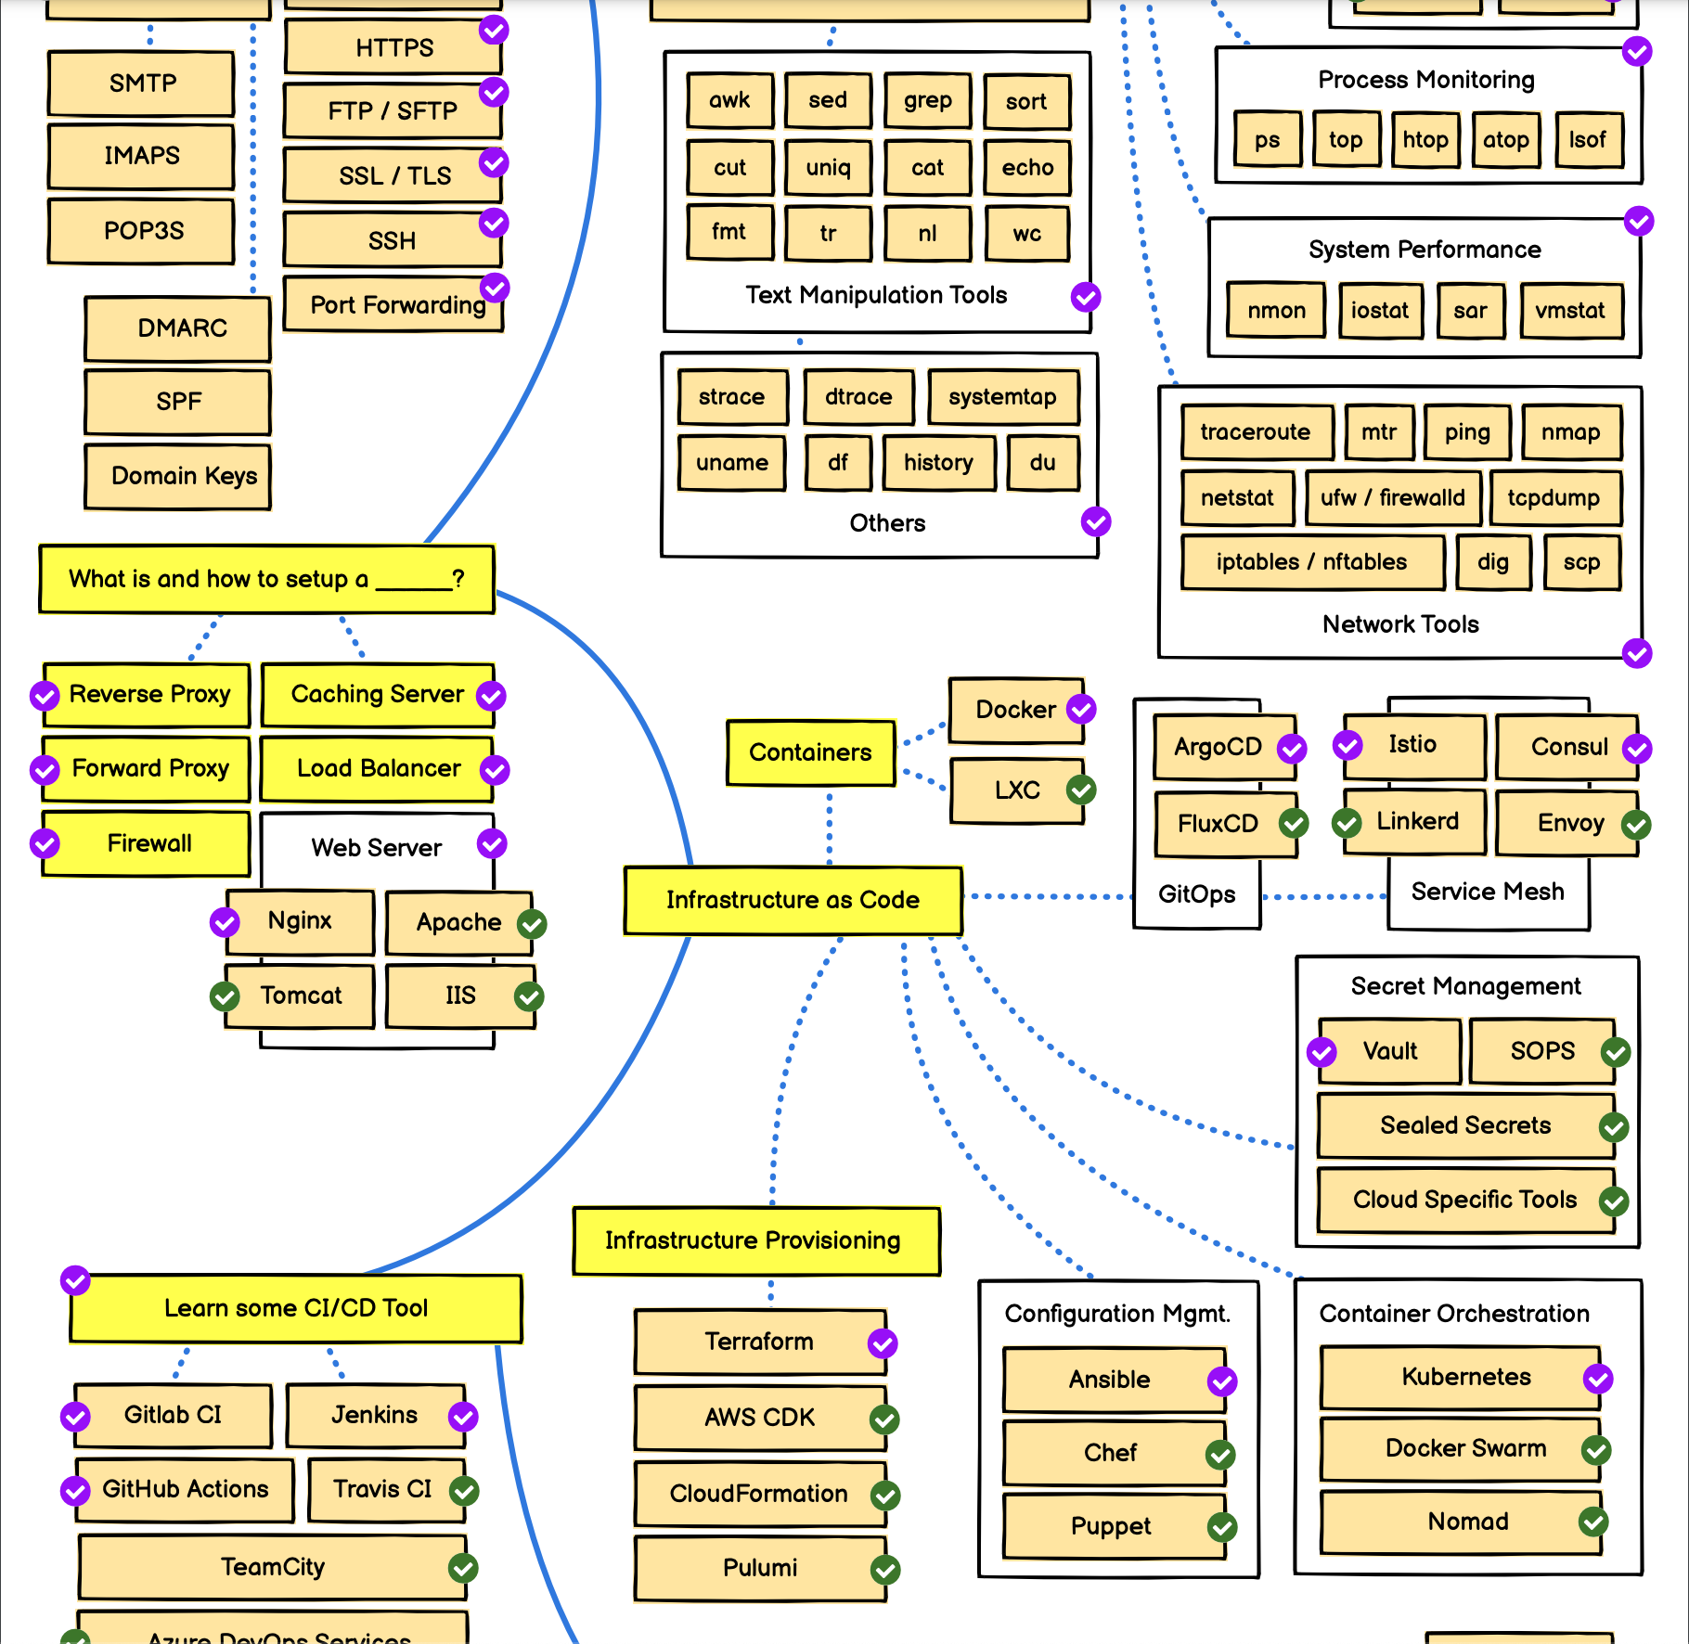
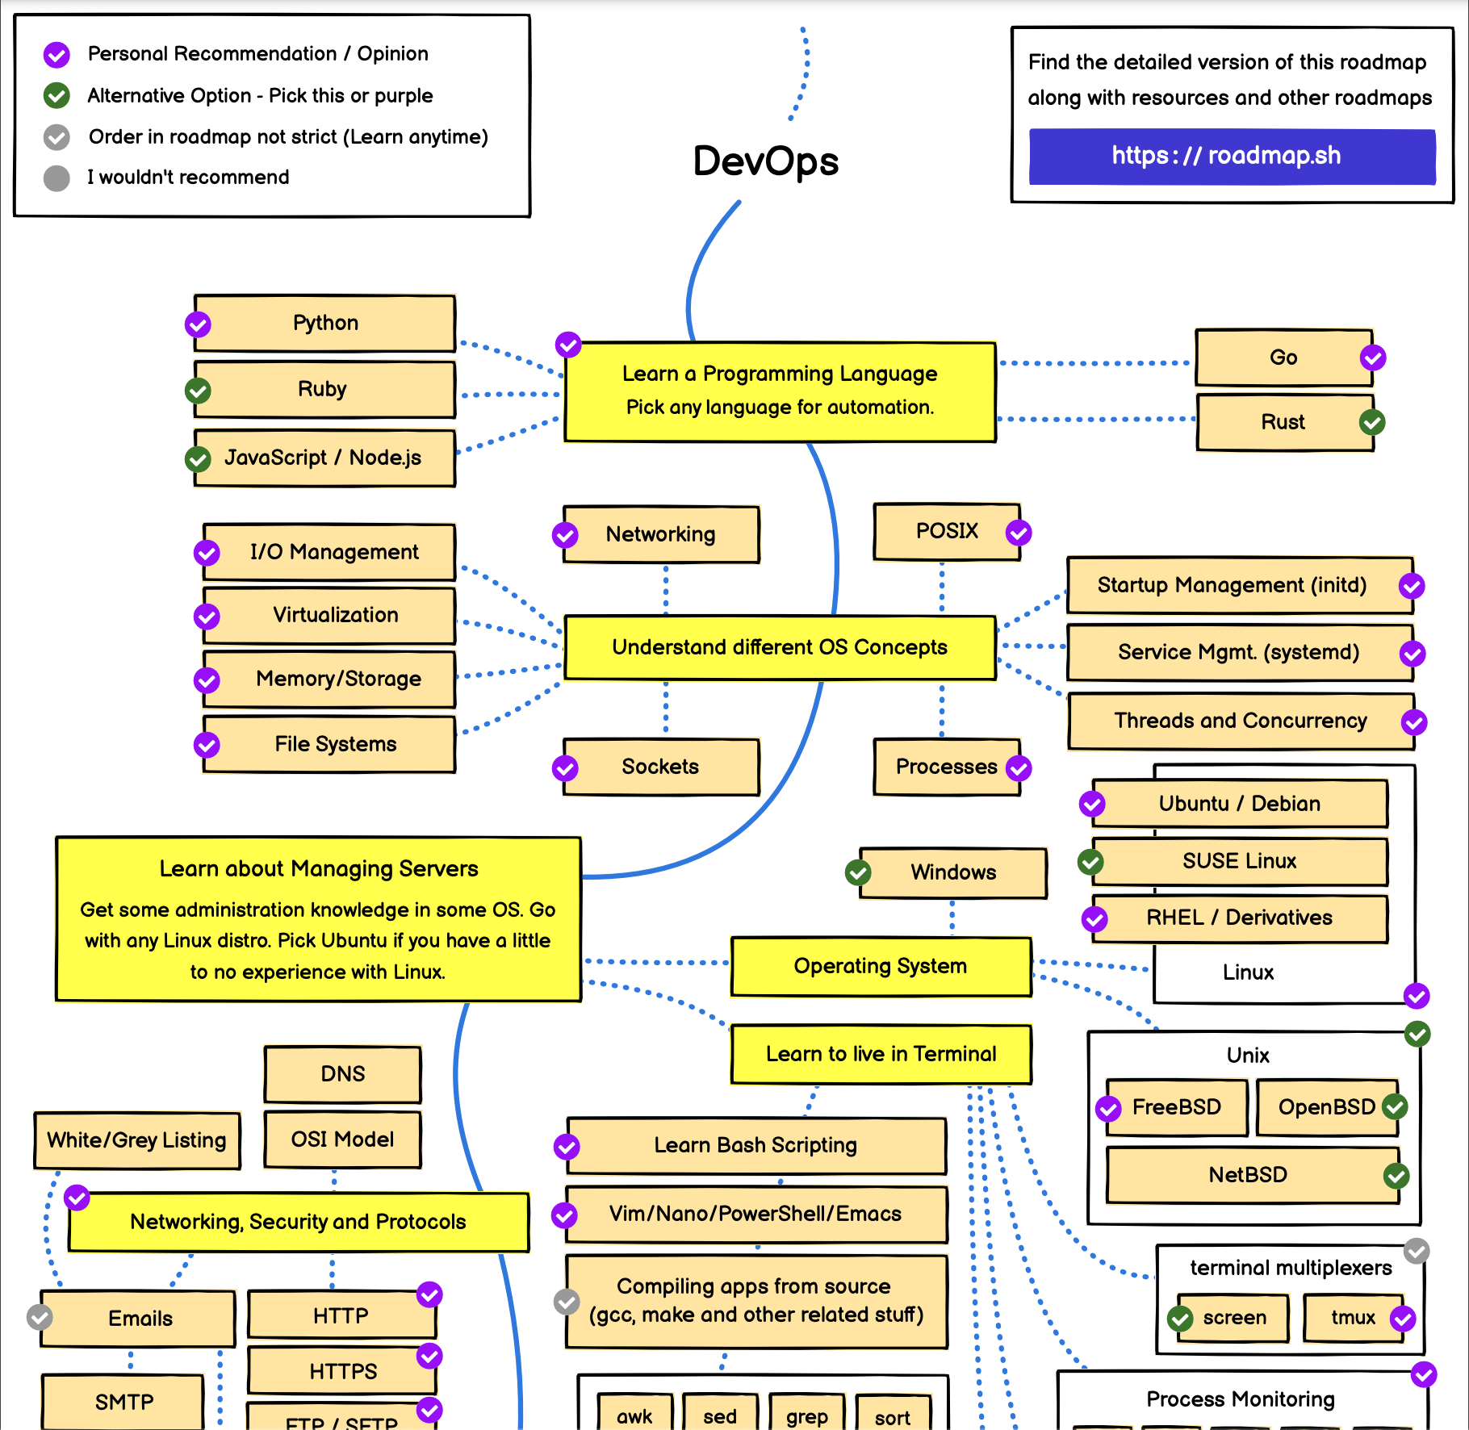
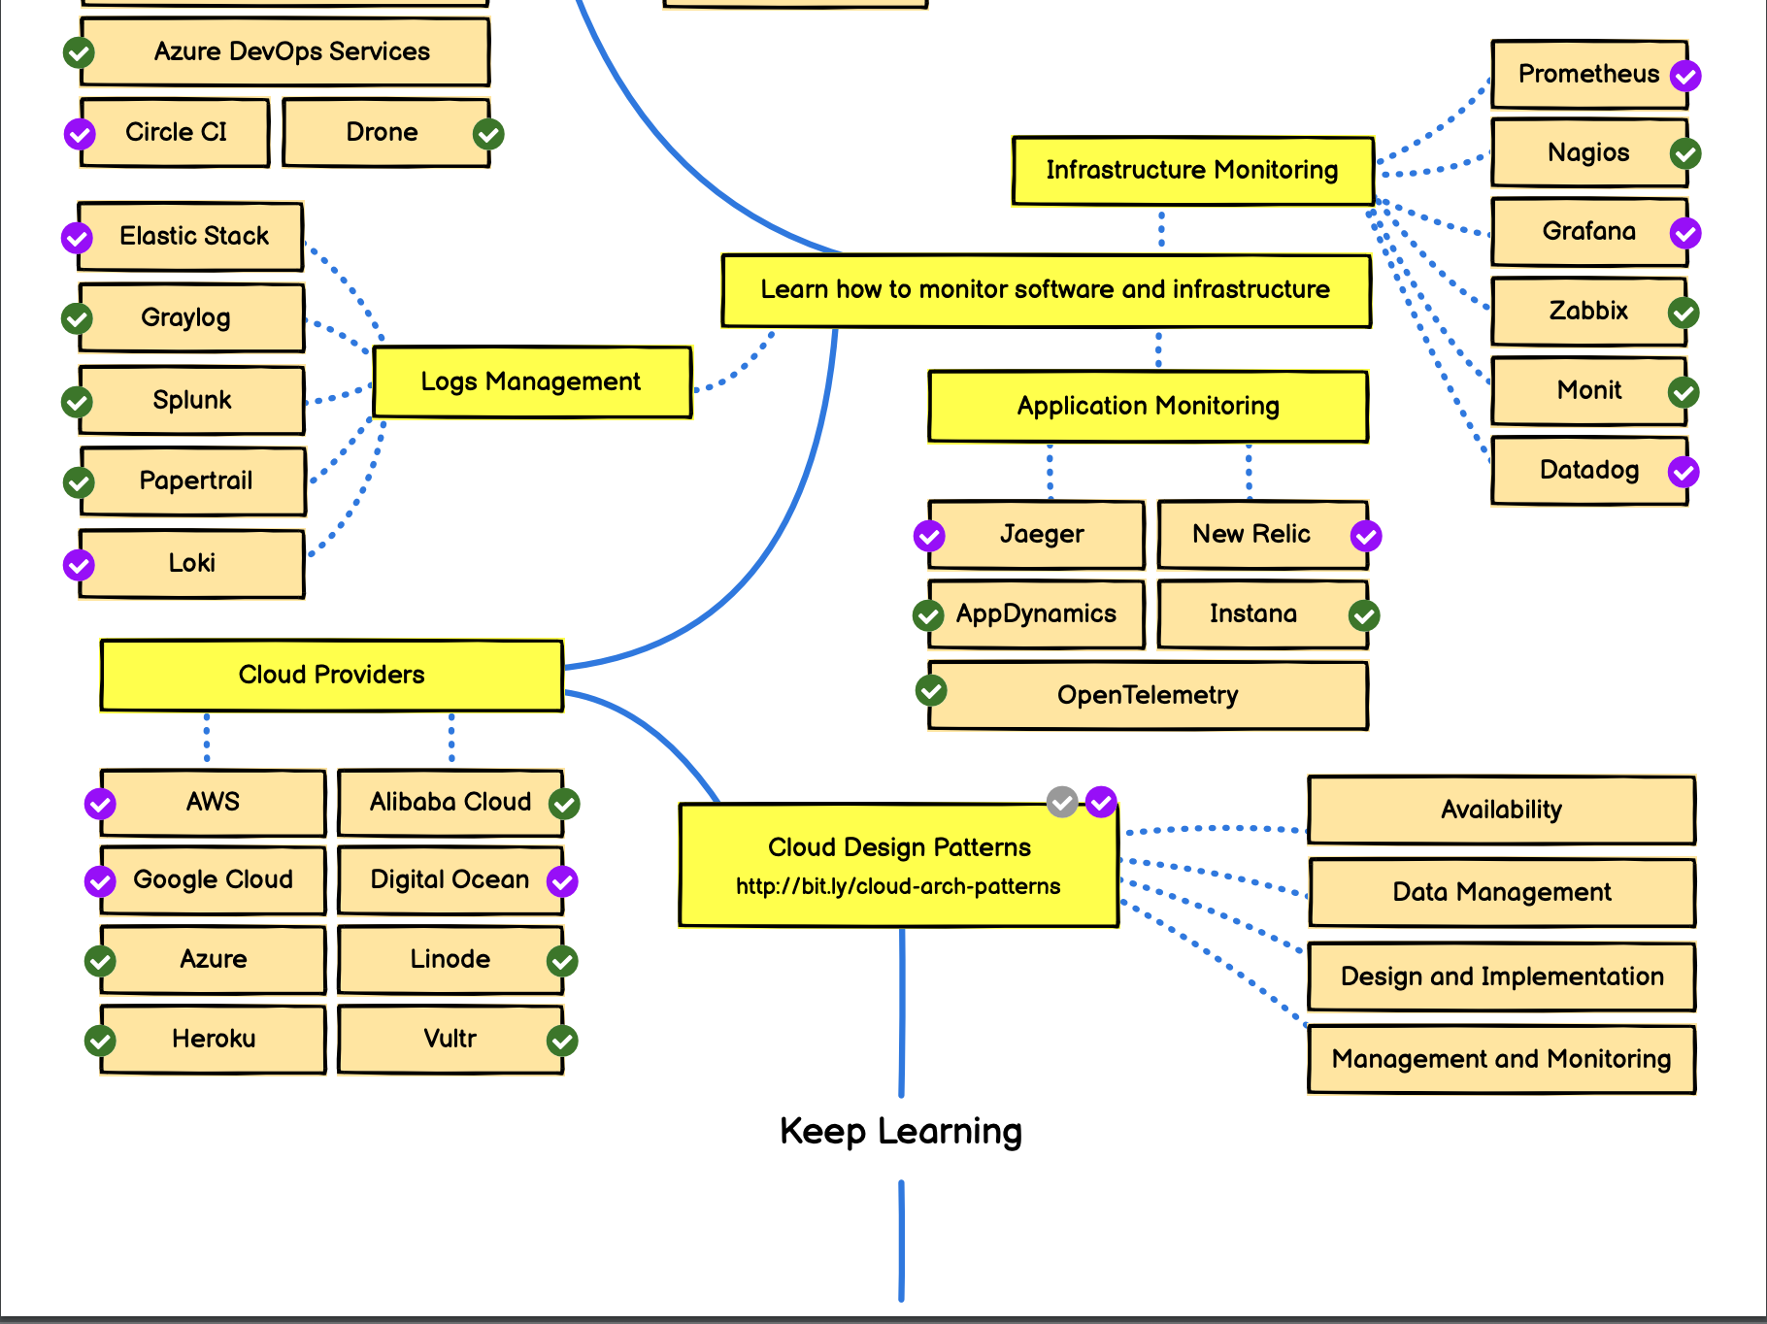
Become DevOps Roadmap
https://roadmap.sh/devops
https://github.com/milanm/DevOps-Roadmap
https://blog.invgate.com/devops-roadmap
2023-DevOps-Roadmap
Become DevOps
DevOps roadmap

Slide 4
Where to learn
Online courses | https://www.pluralsight.com https://www.udemy.com https://kodekloud.com/ https://www.coursera.org https://www.youtube.com/ https://cloudacademy.com/ https://learnit.md https://chat.openai.com/
Practice | https://aws.amazon.com https://azure.microsoft.com/ https://cloud.google.com/ https://github.com/ High school Internship programs Pet projects Open Source Projects Freelance Complex projects
Teach others | Help colleagues Participate to workshops Become a trainer Projects Handover Project documentation
Become DevOps
Learning resources

Slide 5

Importance of Communication
Become DevOps
Community and teams

Slide 6

Bash scripting
Linux commands and tools
bash shell and scripting

Slide 7
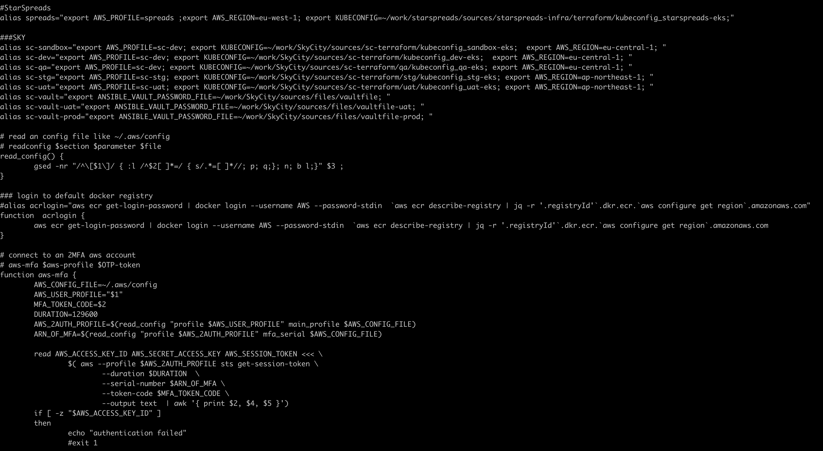
Bash scripting
Linux commands and tools
bash shell and scripting

Slide 8
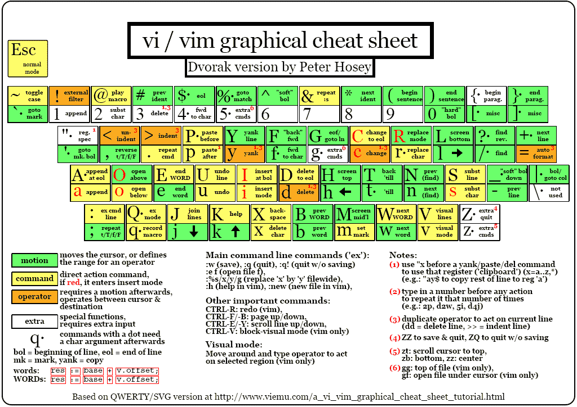
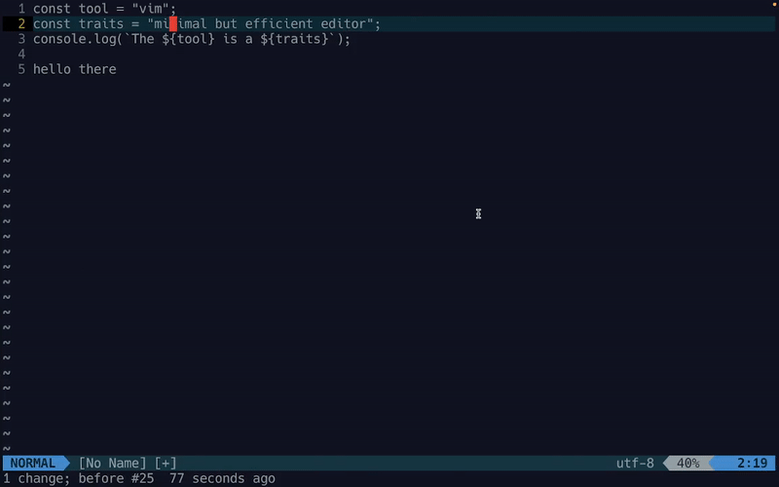
vi editor
Linux commands and tools
vi, grep, sed, awk

Slide 9
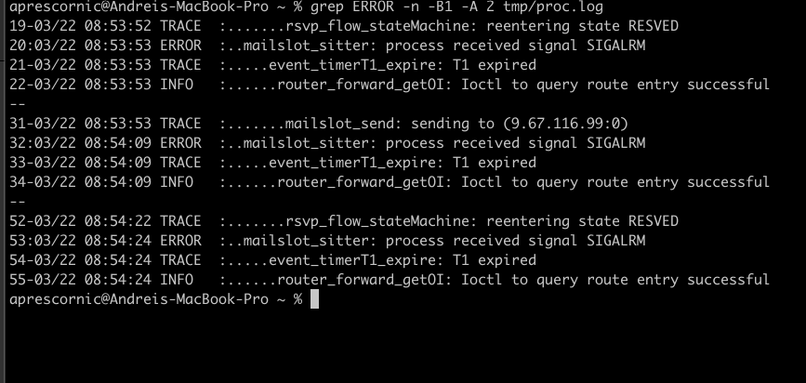
grep
Linux commands and tools
vi, grep, sed, awk

Slide 10
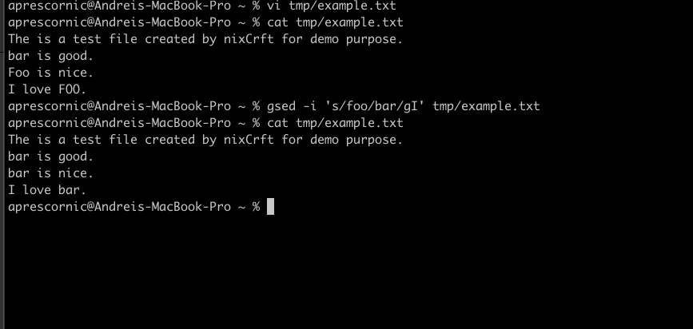
sed
Linux commands and tools
vi, grep, sed, awk

Slide 11
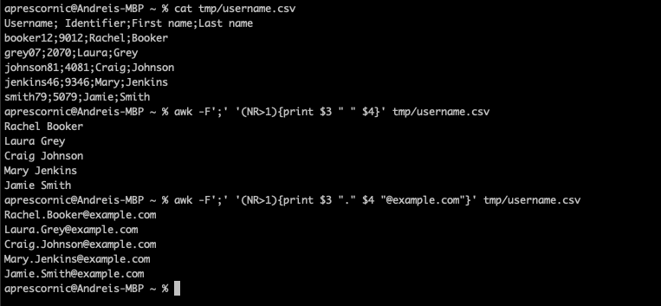
awk
Linux commands and tools
vi, grep, sed, awk

Slide 12
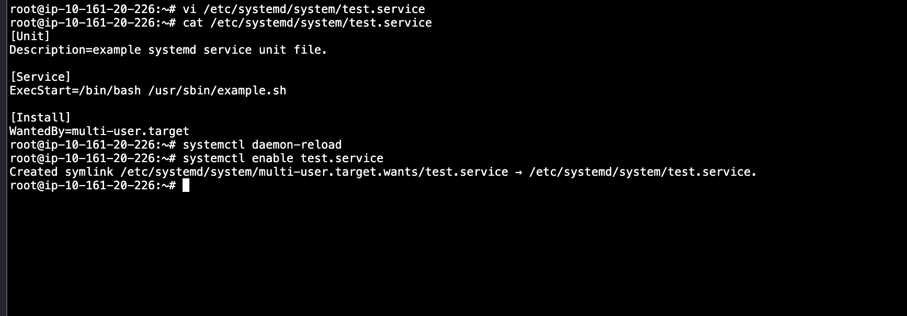
Linux system services
Linux commands and tools
systemd, cron jobs

Slide 13
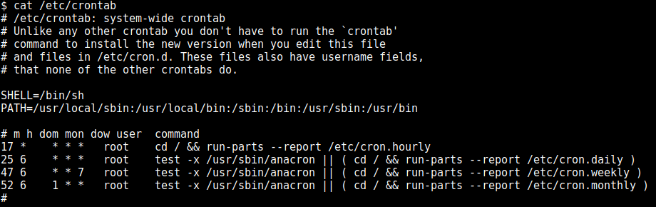
cron jobs
Linux commands and tools
systemd, cron jobs

Slide 14
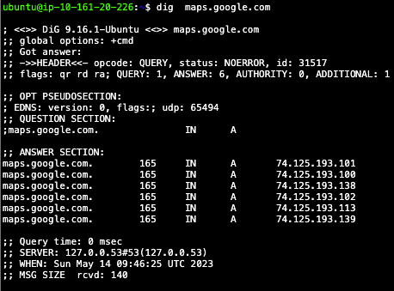
Network commands
ping google.com
ip address show
netstat –rn
netstat –nloutp
ps –aef
dig +short @8.8.8.8 maps.google.com
curl https://tech.dev/mbase/api/player
telnet http://localhost:8080
sudo tcpdump -A -s 10240 'tcp port 8080 and (((ip[2:2] - ((ip[0]&0xf)<<2)) - ((tcp[12]&0xf0)>>2)) != 0)' | egrep --line-buffered "^........(GET |HTTP\/|POST |HEAD )|^[A-Za-z0-9-]+: " | sed -r 's/^........(GET |HTTP\/|POST |HEAD )/\n\1/g'
Network basic tools
Network commands

Slide 15

ssh - most powerful tool
Connect to remote server
ssh –i ~/keys/prod.pkey andreip@10.23.15.148
ssh –l andreip 10.23.15.148
Copy files from/to remote servers
scp –i ~/keys/prod.pkey andreip@10.23.15.148:~/files/file.txt /tmp/
scp –i ~/keys/prod.pkey /tmp/file.txt andreip@10.23.15.148:~/files/
Forward ports from/to remote servers
ssh –f –N –L 3306:10.23.16.125:3306 andreip@10.23.15.148
ssh –fNR 127.0.0.1:3306:10.23.16.125:3306 andreip@10.23.15.148
Access remote servers
Multiple parallel connections
Safe and native on linux
Run remote commands, transfer files, forward remote ports
Network basic tools
ssh

Slide 16
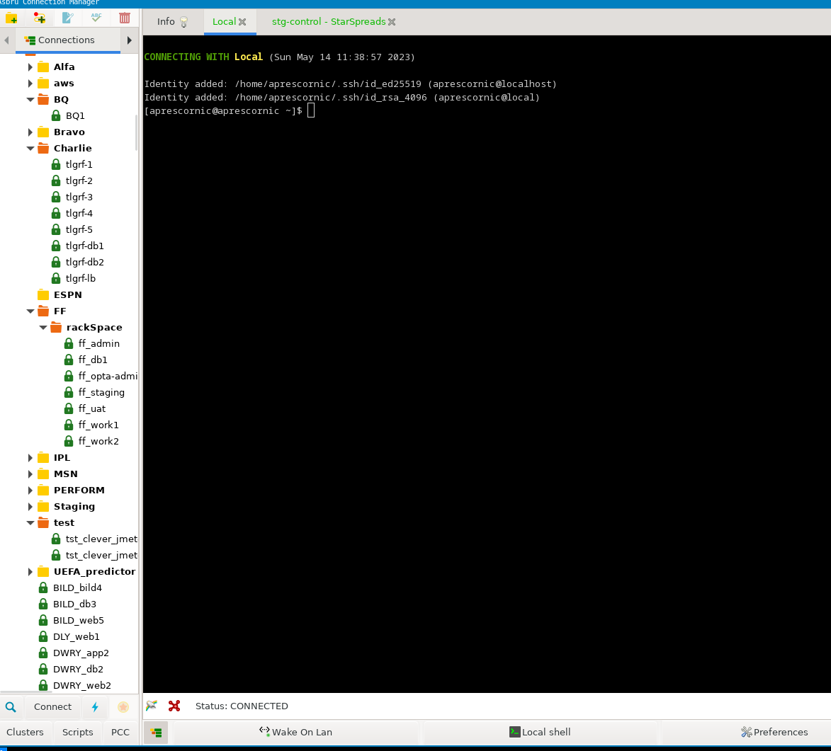
Remote connection manager
Network basic tools
Connection managers

Slide 17
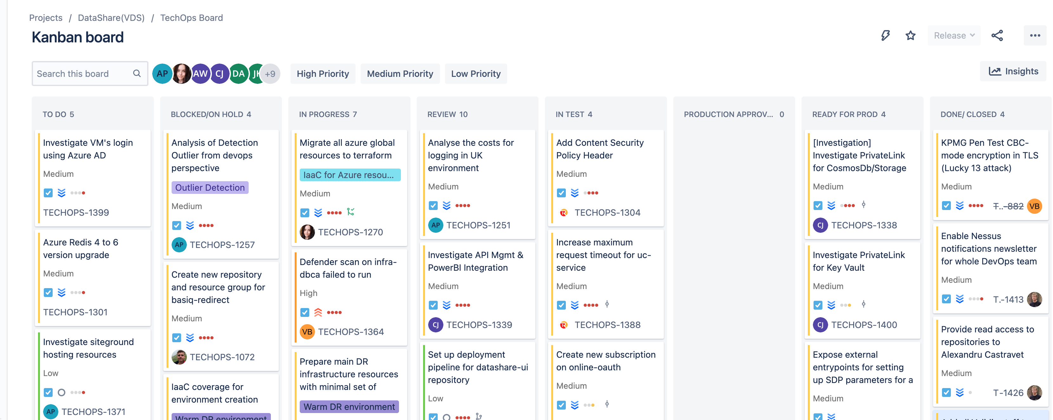
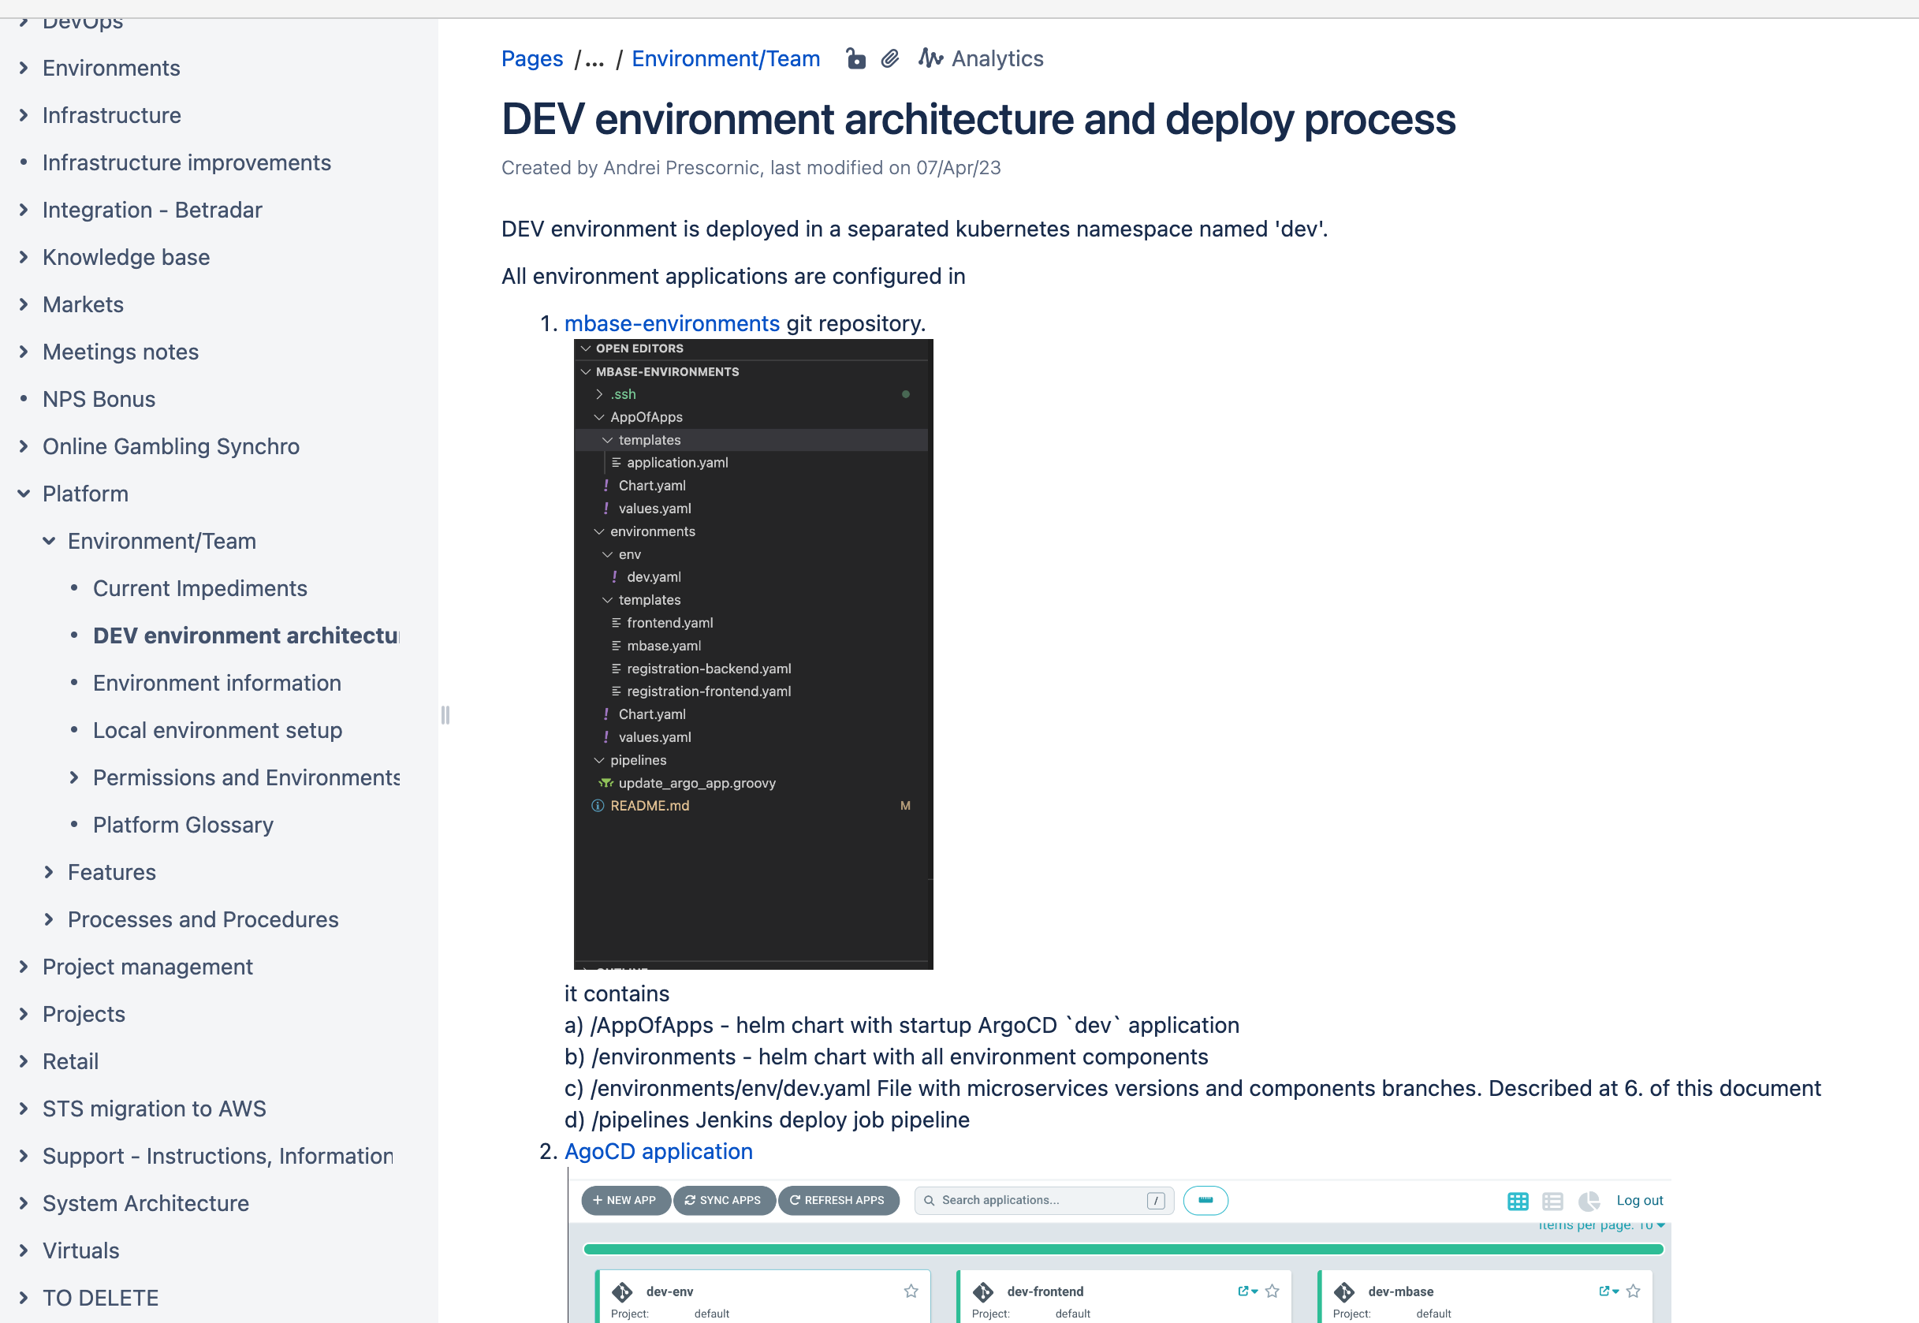
Project collaboration
Collaborating
Tasks planning, Wiki

Slide 18
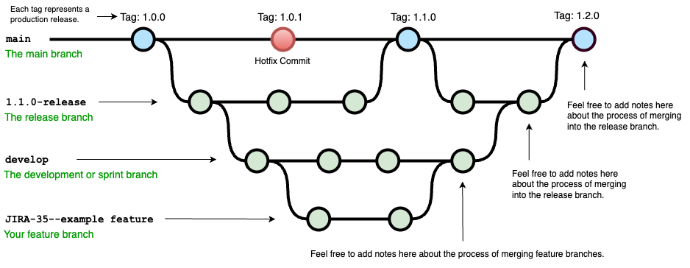
git branches
Collaborating
Git

Slide 19
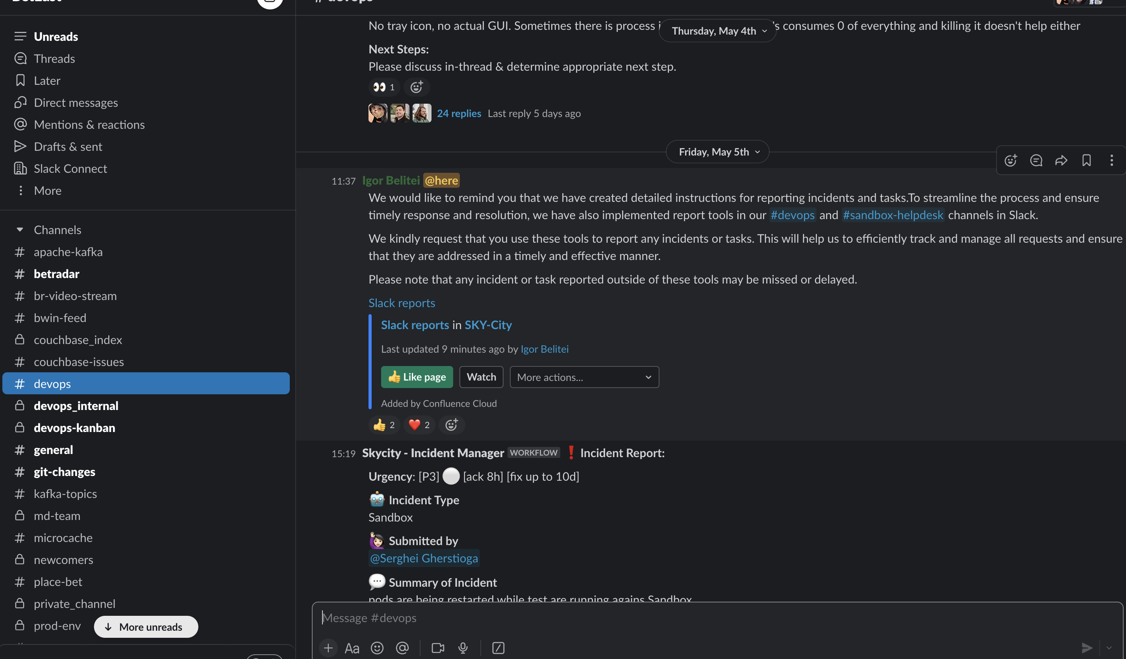
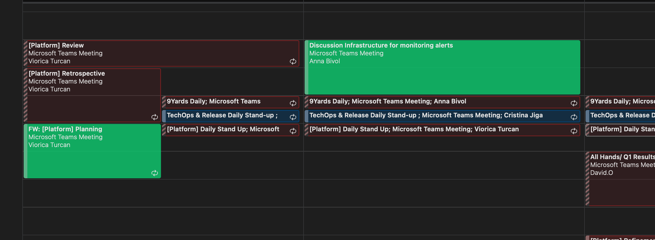
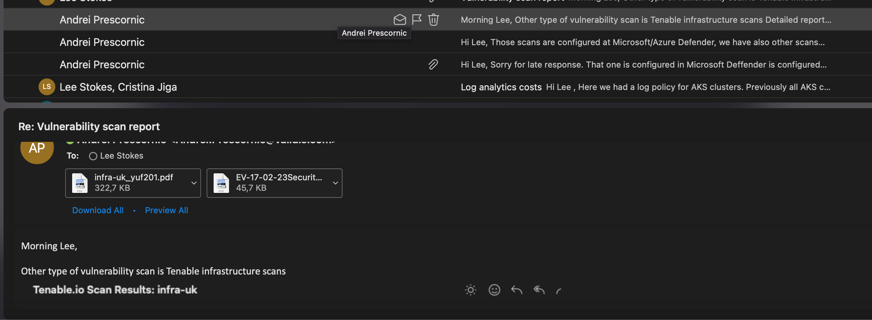
Communication
Collaborating
Communication

Slide 20
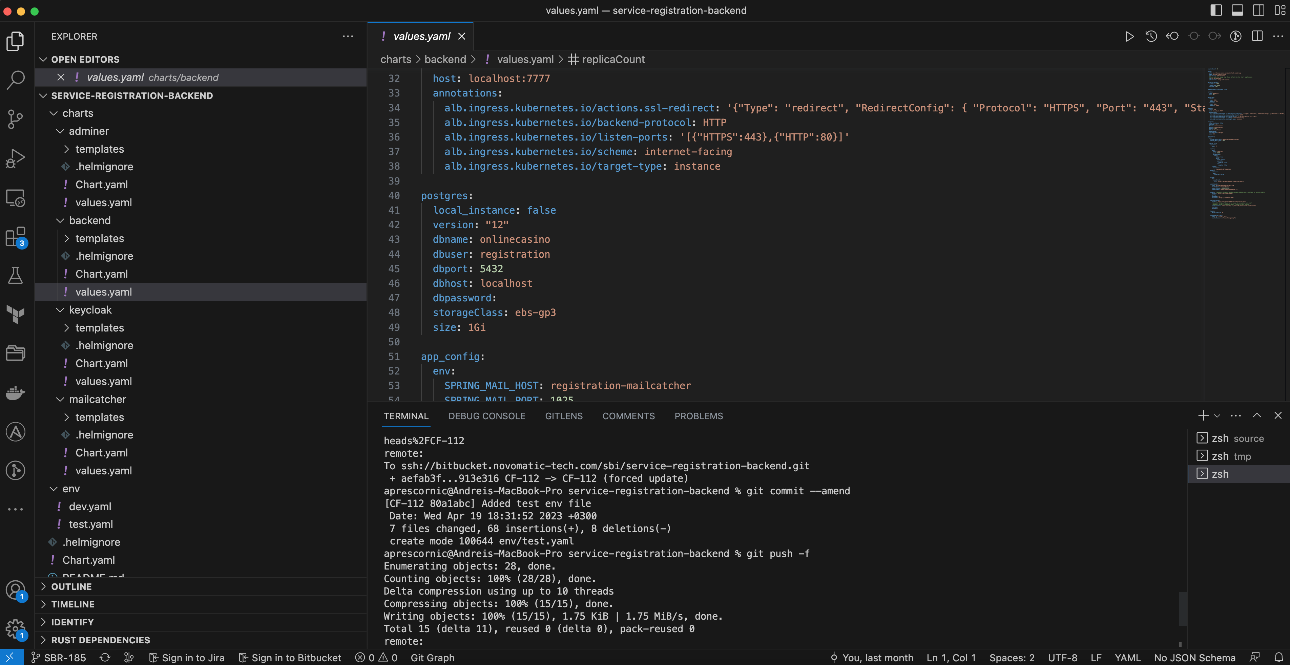
IDE Integrated Development Environment
IDE and coding
IDE

Slide 21
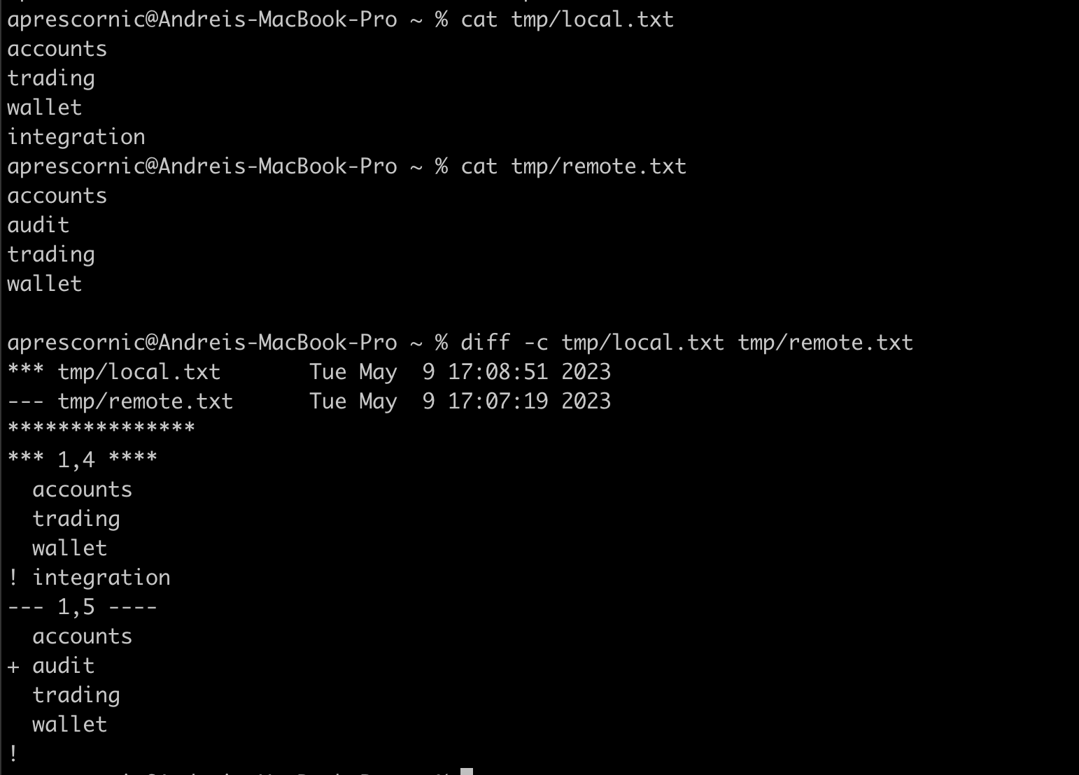
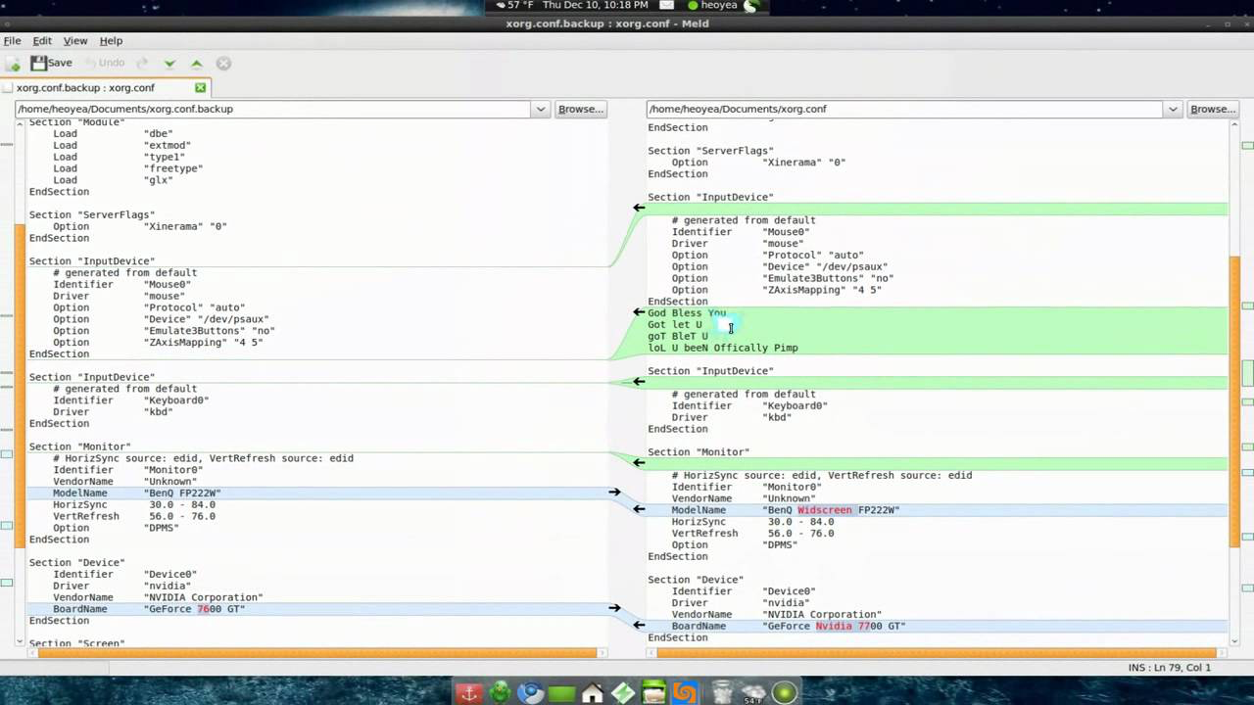
diff
IDE and coding
diff and comparing content

Slide 22
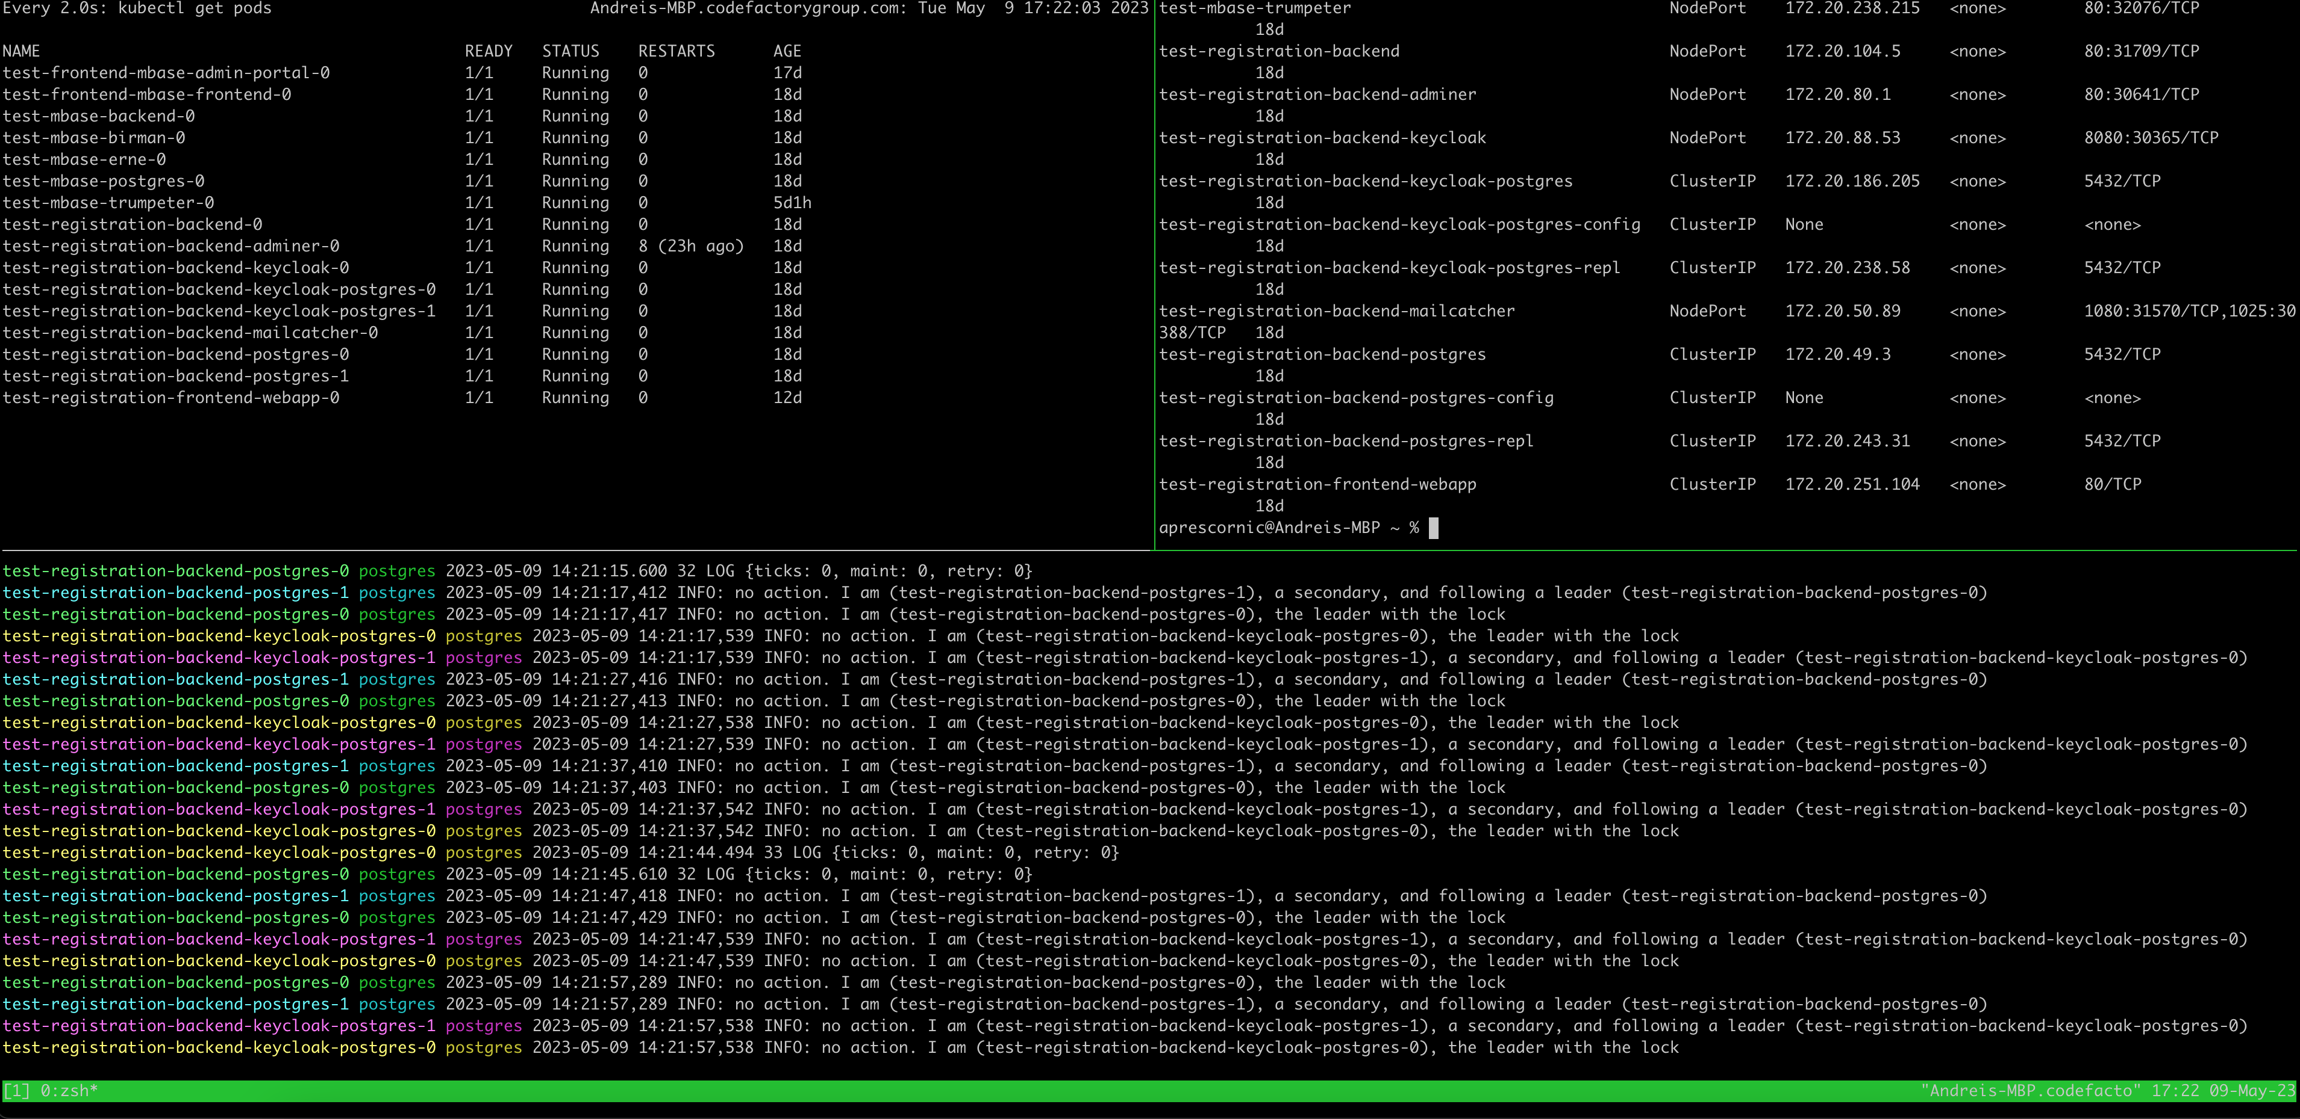
Local console
IDE and coding
tmux, screen

Slide 23
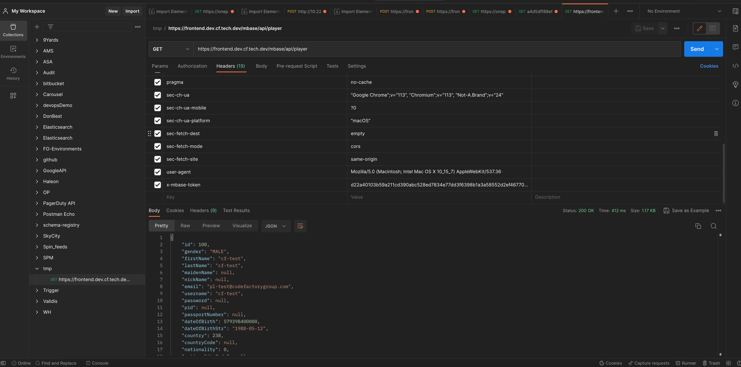
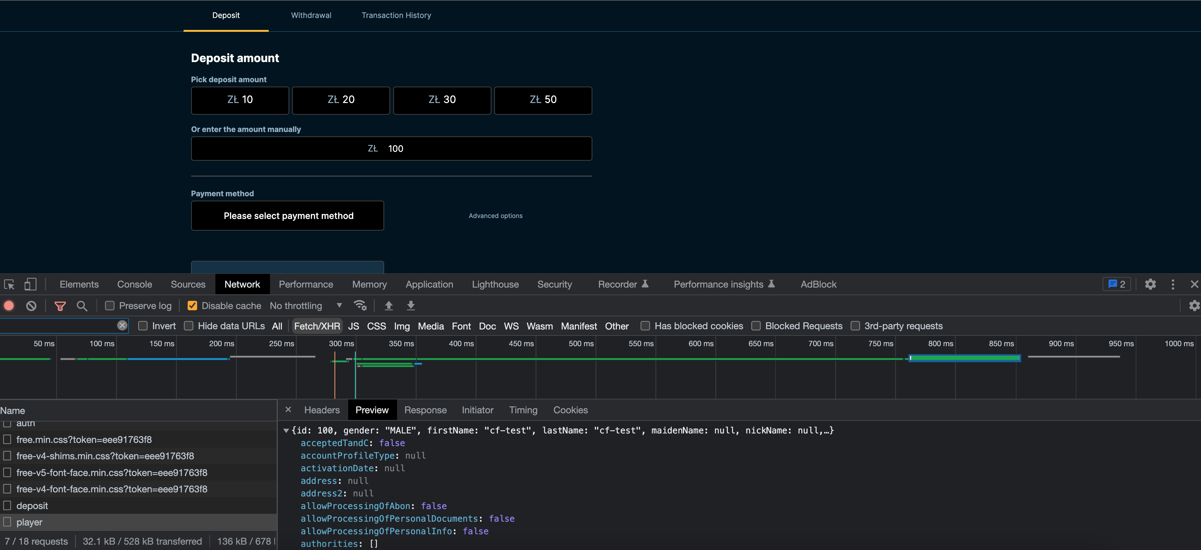
WEB API tools
Testing and investigating
Browser and web tools

Slide 24
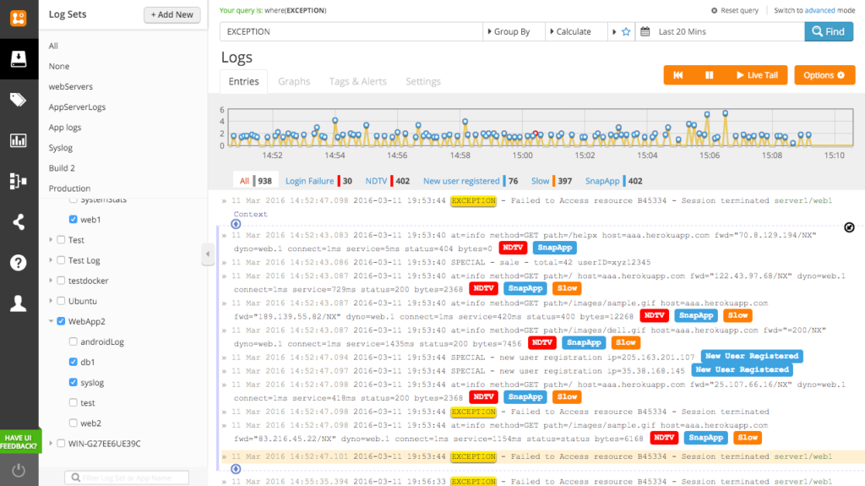
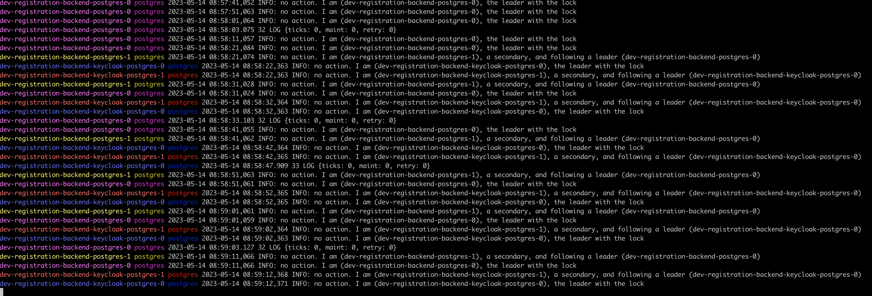
Logging tools
Testing and investigating
Logging tools

Slide 25
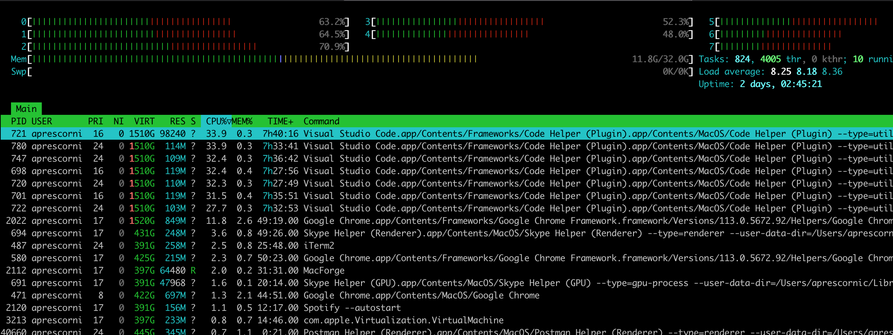
Monitoring tools
Testing and investigating
Monitoring

Slide 26

Become DevOps with us
Website
https://devops-moldova.github.io/
Telegram
https://t.me/devops_moldova
Facebook
https://www.facebook.com/groups/devops.md
Youtube
https://www.youtube.com/@DevopsCommunityMoldova
Github
https://github.com/DevOps-Moldova

